Slide 1
To-Be: Recruit and Select Resource – Main Process Flow

Slide 2
Shortlist and Select Candidates

Slide 3
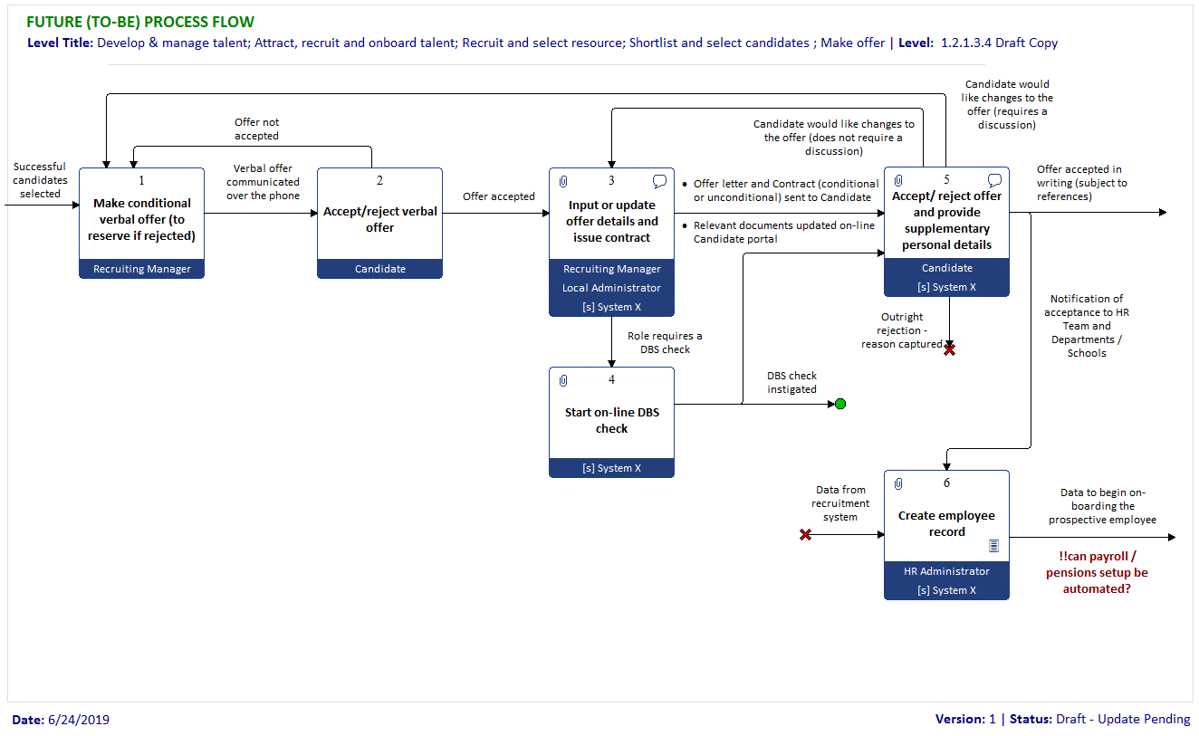
Make Offer

Slide 4
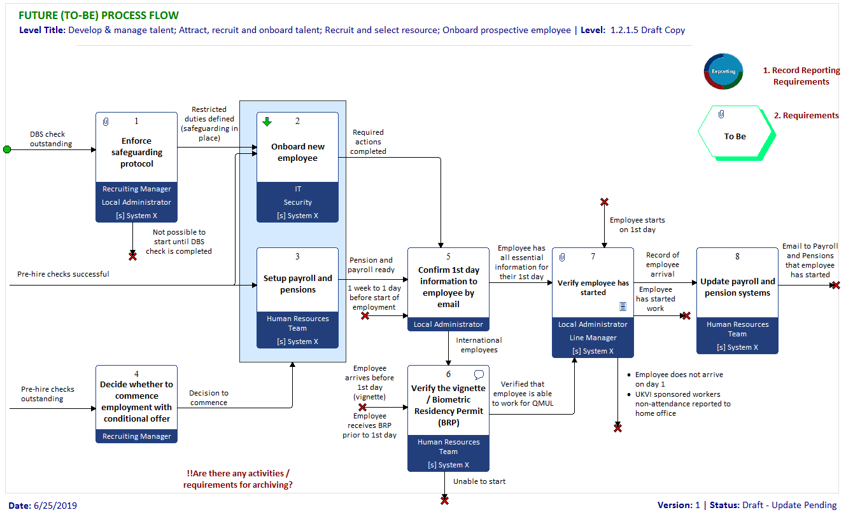
Oboard prospective employee

Slide 5
Onboard New Employee

